Slide 1

Limited Direct Execution
PASS - see feedback for #6
CS532: OS Foundations
Lab Assignment
email address: parth2@pdx.edu
partner’s email address: NA

Slide 2
Instructions: Make a copy of this document, move your copy to your submissions folder and fill the document with your responses. Use the space on each slide to show your responses, and add additional slides as needed.
When ready for grading: complete the lab assignment submission form and include a link to your filled document

Slide 3
1. login to linux.cs.pdx.edu and run the command "vmstat -w 1 60". Widen your terminal window until a single line of stats fits on a single line of your terminal window. vmstat will print various OS statistics each second and finish after 60 seconds. read the tool's man page (run "man vmstat") to decipher the meaning of the statistics. Specifically, we are interested in its counts of interrupts (in) and context switches (cs). During your 60 seconds of observations, which occurred more frequently on ada.cs.pdx.edu, interrupts or context switches?

Slide 4
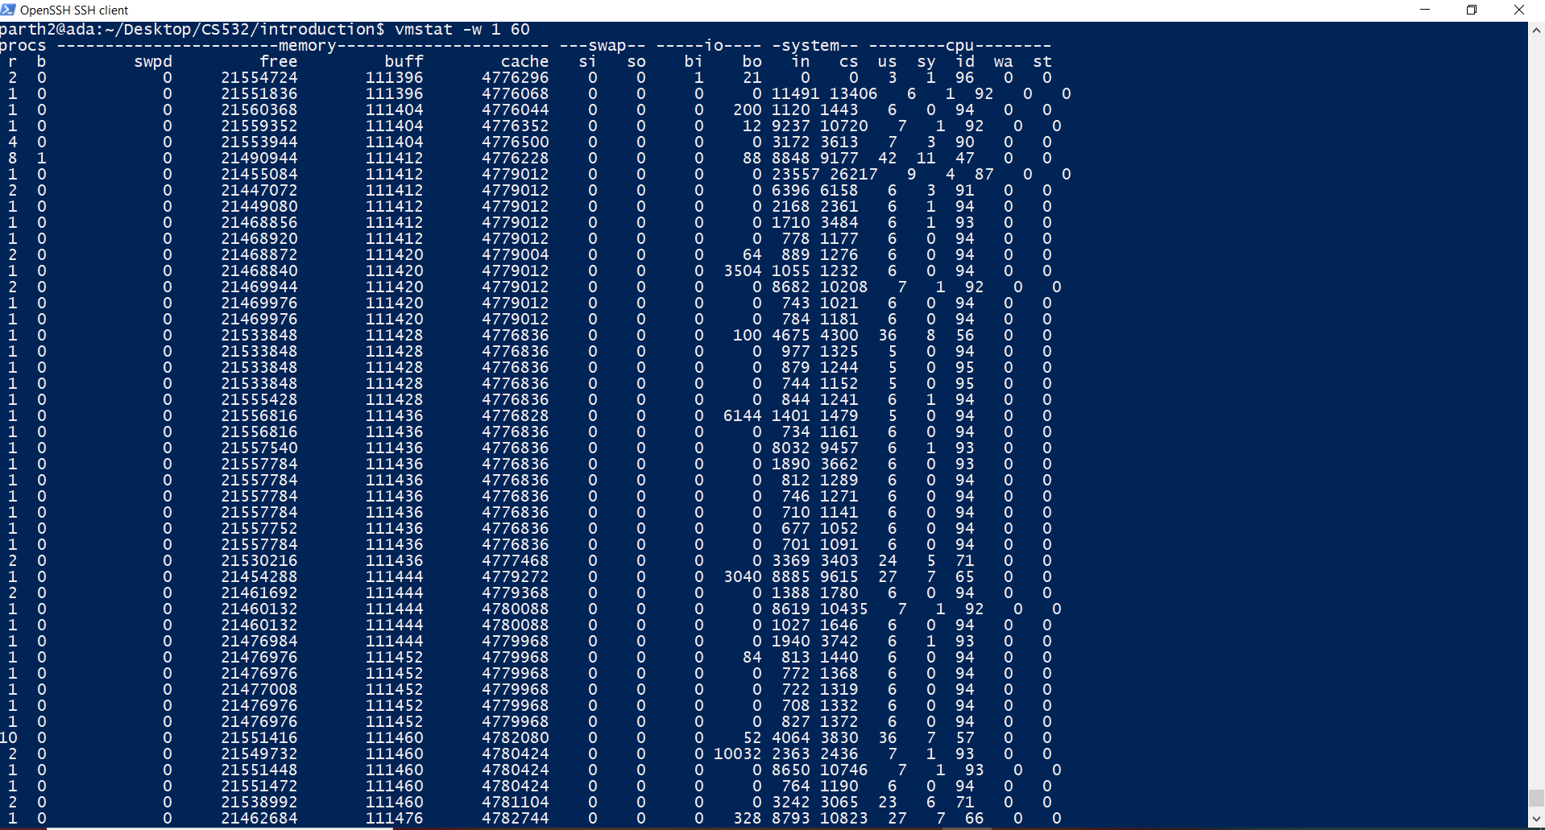

Slide 5
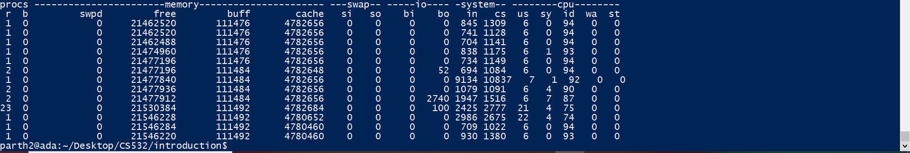
As we can see in the screenshots above depicting the vmstat, we can see that , generally, at any given second, the number of context switches (cs) are more than the number of interrupts.

Slide 6
2. What was the highest rate of interrupts that you observed for any 1 second interval?
Answer:- From the screenshots in the previous question, we can see that the highest number of interrupts observed for any one second interval is 23557.

Slide 7
3. What was the highest rate of context switches that you observed for any 1 second interval?
Answer:- For any given second (in the screenshots), the highest number of context switches that i observed was :- 26217

Slide 8
Compile and run the program TestLimits01.c.
Compile it like this:
gcc -Wall -Werror TestLimits01.c -o TestLimits01
and run it like this:
./TestLimits01

Slide 9
4. What feature of the operating system limits the direct execution of TestLimits01 and prevents it from running forever? (highlight any that apply)
A. periodic timer interrupt allows OS to schedule itself and other processes
B. MMU prevents access to kernel memory
C. mode bit prevents execution of privileged instructions
D. system call interface
E. other (describe)

Slide 10
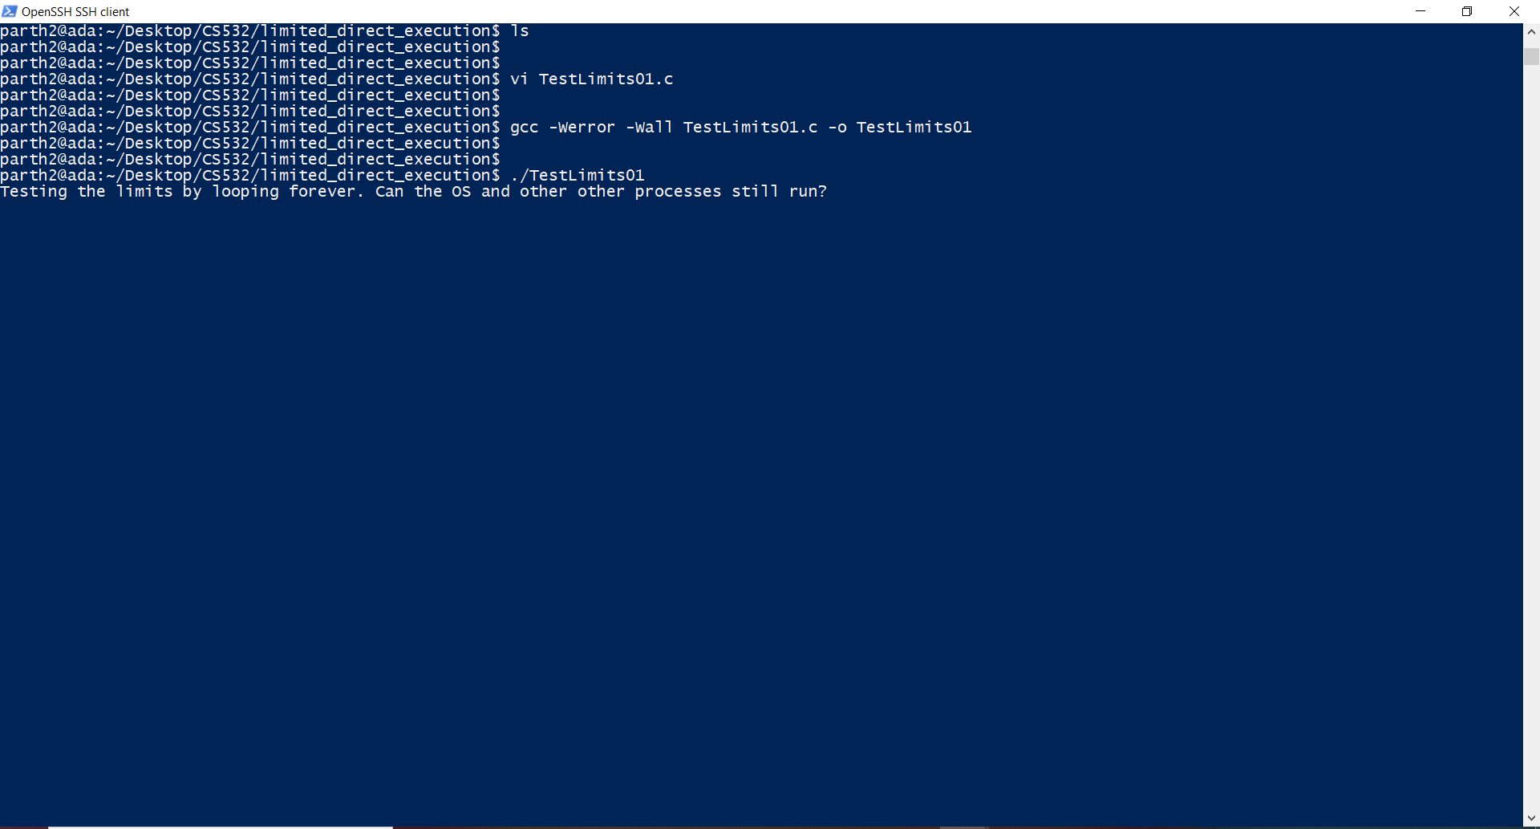

Slide 11
5. Compile and run the program TestLimits02.c. What feature of the operating system limits the direct execution of this program and prevents it from reading kernel memory?
A. timer interrupt
B. MMU
C. privileged mode
D. system call interface
E. other (describe)

Slide 12
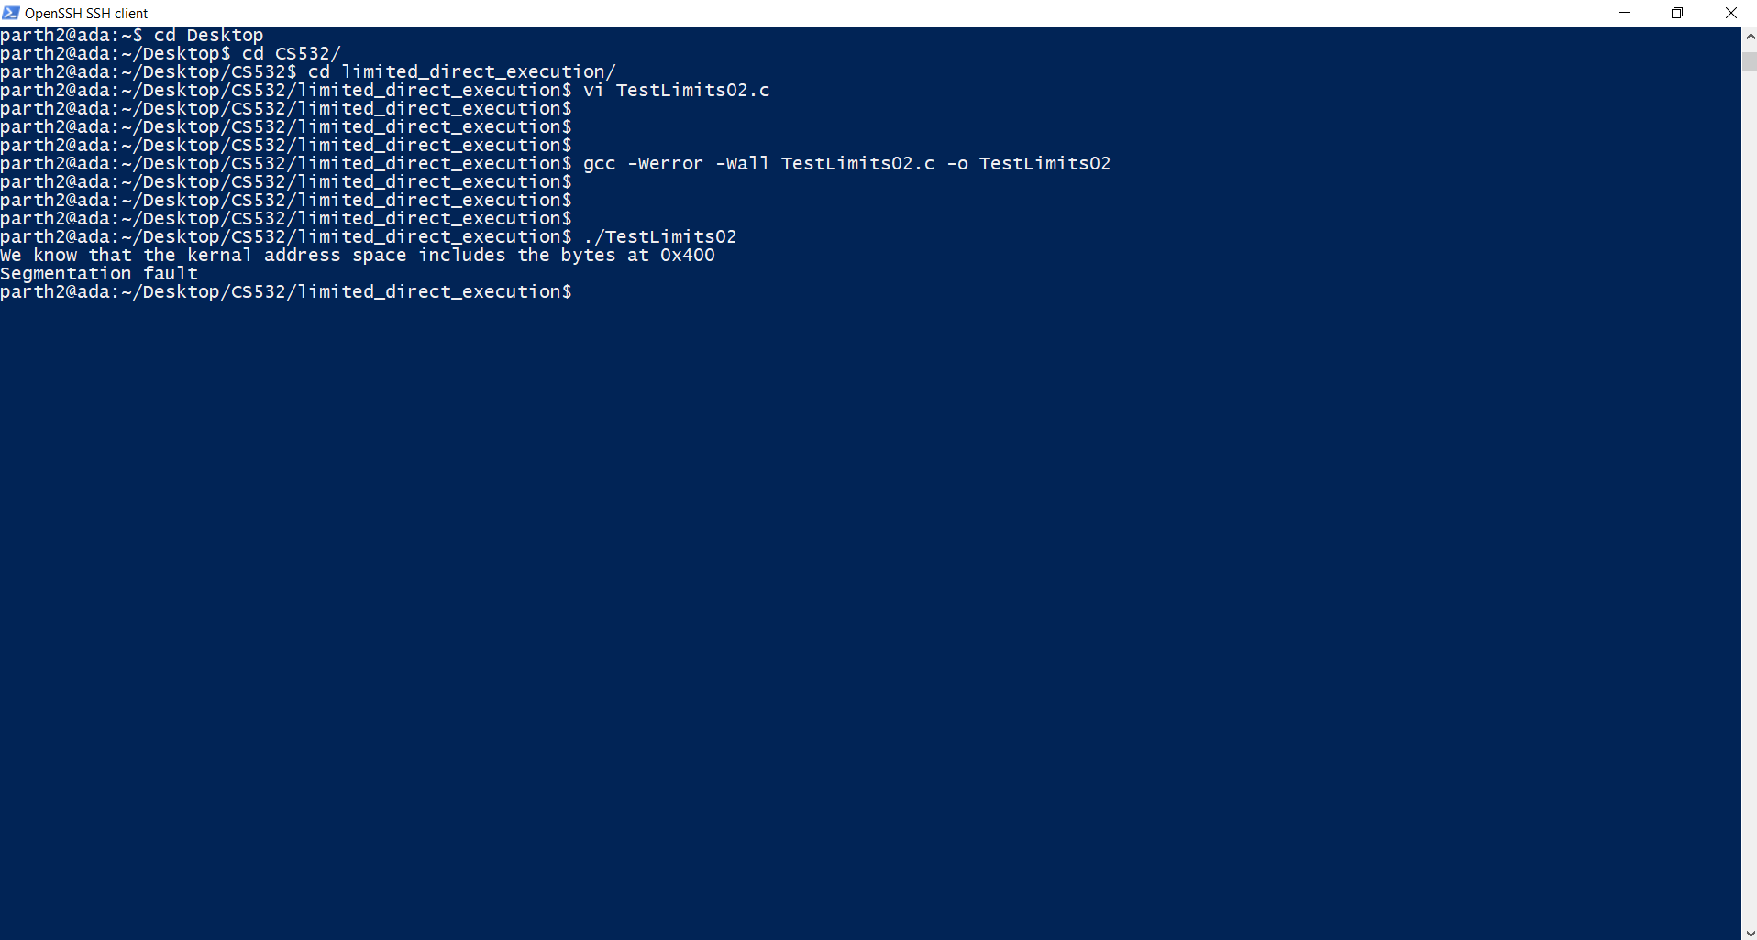

Slide 13
6. Compile and run the program TestLimits03.c. What feature of the system limits the direct execution of this program and prevents it from writing to a file for which it does not have permission?
A. timer interrupt
B. MMU
C. privileged mode
D. system call interface
E. other (describe)
I’m OK with C, but D is a better response because the file access checking occurs within the implementation of the write() system call.

Slide 14
